Slide 1
Fuzzy logic System
Course: Soft Computing
Course Code: 22AIP3202
CO - 1
Session - 2

Slide 2




AIM OF THE SESSION
To familiarize students with the concepts of fuzzy logic.
To make students understand the fuzzy set.
INSTRUCTIONAL OBJECTIVES
This unit is designed to:
Demonstrate fuzzy logic and control system
Describe the difference between classical and fuzzy set theory
List out the different membership functions
LEARNING OUTCOMES
At the end of this unit, you should be able to:
Define the functions of set theory, membership function
Summarize the techniques used for building the membership function
Describe ways to build the soft systems

Slide 3

Fuzzy Set Theory
The word “fuzzy” means “vagueness (ambiguity)”.
Fuzziness occurs when the boundary of a piece of information is not clear-cut.
Fuzzy sets - 1965 Lotfi Zadeh defines as an extension of classical notation set.
Classical set theory allows the membership of the elements in the set in binary terms.
Fuzzy set theory permits membership function valued in the interval [0,1].
Lotfi A. Zadeh

Slide 4
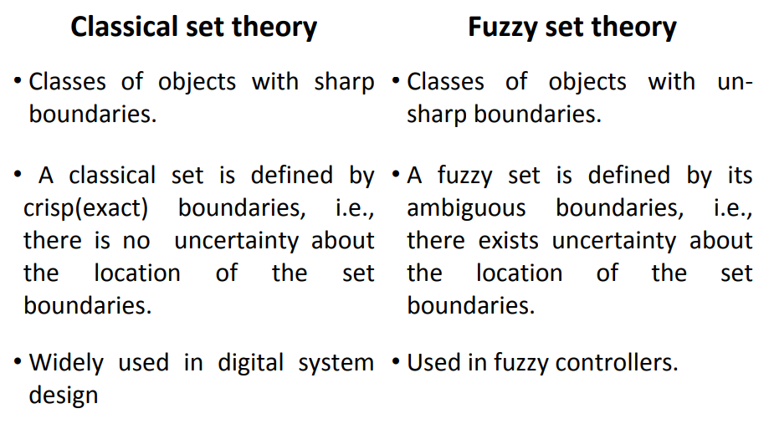
Classical set v/s Fuzzy Set Theory

Slide 5
Example : Fuzzy v/s Crisp
Yes! (1)
Is water colorless?
Crisp
No! (0)
Extremely Honest (1)
Very Honest (0.80)
Fuzzy
Honest at time (0.40)
Is Ram Honest?
Extremely dishonest (0.0)

Slide 6
Classical set theory
A Set is any well defined collection of objects.
An object in a set is called an element or member of that set.
Sets are defined by a simple statement, describing whether a particular element having a certain property belongs to that particular set.
A = {a₁, a₂, a₃,……,a_{n}}
If the elements A_{i} (i = 1,2,3,….,n) of a set A are subset of universal set X, then set A can be represented for all elements x ϵ X by its characteristics function
µ_{A} (x) = 1 if x ϵ X otherwise 0

Slide 7
Operations on classical set theory
Union: the union of two sets A and B is given as
A U B = { x | x є A or x є B }
Intersection: the intersection of two sets A and B is given as
A ∩ B = { x | x є A and x є B }
Complement: It is denoted by Ã and is defined as
Ã = { x | x does not belongs A and x є X }

Slide 8
Fuzzy Sets
Fuzzy sets theory is an extension of classical set theory.
Elements have varying degree of membership. A logic based on two truth values, True and False is sometimes insufficient when describing human reasoning.
Fuzzy Logic uses the whole interval between 0 (false) and 1 (true) to describe human reasoning.
A Fuzzy Set is any set that allows its members to have different degree of membership, called membership function, having interval [0,1].

Slide 9
Fuzzy Sets
Fuzzy Logic is derived from fuzzy set theory
Many degree of membership (between 0 to 1) are allowed
Thus a membership function µA(x) is associated with a fuzzy
sets Ã such that the function maps every element of universe of discourse X to the interval [0,1].
The mapping is written as: µ_{Ã}(x): X є [0,1].
Fuzzy Logic is capable of handling inherently imprecise (vague or inexact or rough or inaccurate) concepts

Slide 10
Fuzzy Sets
Fuzzy set is defined as follows:
If X is an universe of discourse and x is a particular element of X, then a fuzzy set A defined on X and can be written as a collection of ordered pairs
A = {(x, µ_{Ã}(x)), x є X }

Slide 11
Fuzzy Sets (Cont...)
Example
Let X = {g₁, g₂, g₃, g₄, g₅} be the reference set of students.
Let Ã be the fuzzy set of “smart” students, where “smart” is fuzzy term.
Ã = {(g₁,0.4)(g₂,0.5)(g₃,1)(g₄,0.9)(g₅,0.8)}
Here Ã indicates that the smartness of g₁ is 0.4 and so on

Slide 12
Fuzzy Sets (Continue)
Membership Function
The membership function fully defines the fuzzy set
A membership function provides a measure of the degree of similarity of an element to a fuzzy set
Membership functions can
either be chosen by the user arbitrarily, based on the user’s experience (MF chosen by two users could be different depending upon their experiences, perspectives, etc.)
Or be designed using machine learning methods (e.g., artificial neural networks, genetic algorithms, etc.)

Slide 13
Fuzzy Sets (Continue)
There are different shapes of membership functions;
•
•
•
Triangular, Trapezoidal, Gaussian, etc

Slide 14
Fuzzy Sets (Continue)
Triangular membership function
A triangular membership function is specified by three parameters {a, b, c} a, b and c represent the x coordinates of the three vertices of µ_{A}(x) in a
fuzzy set A (a: lower boundary and c: upper boundary where membership degree is zero, b: the centre where membership degree is 1)
µ_{A}(x)
1
⎧0
if x ≤ a
⎫
⎪ x − a
⎪
⎪
if a ≤ x ≤ b⎪
μ (x) = ^{⎪b − a}
⎪
A
⎬
⎨c − x
⎪
⎪c − b
⎪₀
if b ≤ x ≤ c ⎪
⎪
x
if x ≥ c
⎪
0
⎩
⎭
a
b
c

Slide 15
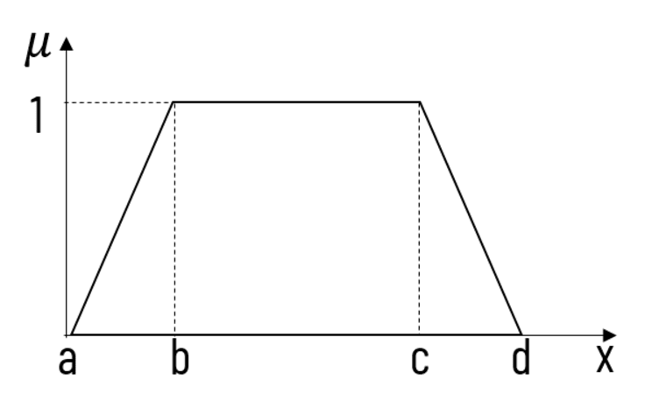
Fuzzy Sets (Continue)
•
•
Trapezoid membership function
A trapezoidal membership function is specified by four parameters {a, b, c, d} as follows:
⎧0
if x ≤a
⎫
⎪
⎪x −a
⎪
if a ≤ x ≤b ⎪
⎪b −a
⎪
μ (x) =⎪
⎨1
if b ≤ x ≤c ⎪
⎬
⎪
if c ≤ x ≤d ⎪
⎪
A
⎪d −x
⎪
⎪d −c
⎪_{⎩0}
if d ≤ x
⎪⎭

Slide 16
Gaussian membership function
⎡
1 x − c ^{m ⎤}
μ_{A} (x, c, s, m) = exp⎢− ₂
⎥
⎥⎦
⎢⎣
s
c: centre
s: width
m: fuzzification factor (e.g., m=2)
µ_{A}(x)
1
c=5 s=2 m=2
0.9
0.8
0.7
0.6
0.5
0.4
0.3
0.2
0.1
x
0
0
1
2
3
4
5
6
7
8
9
10

Slide 17
c=5 s=0.5
1
0.9
0.8
0.7
0.6
0.5
0.4
0.3
0.2
m=2
0.1
0
0
1
2
3
4
5
6 7
8
9
10
1
0.9
c=5 s=5 m=2
0.8
0.7
0.6
0.5
0.4
0.3
0.2
0.1
0
0 1
2
3
4
5
6
7
8
9
10

Slide 18
Summary
Following figures shows a typical examples of membership functions.
µ
µ
µ
x
x
x
< triangular >
< trapezoidal >
< curve >
µ
µ
x
x
< non-uniform >
< non-uniform >

Slide 19
Fuzzy Set Operation
Given X to be the universe of discourse and Ã and Ḃ to be fuzzy sets with µ_{A}(x) and µ_{B}(x) are their respective
membership function, the fuzzy set operations are as follows:
Union:
µ_{A U B}(x) = max (µ_{A}(x), µ_{B}(x))
Intersection:
µ_{A ∩ B}(x) = min (µ_{A}(x), µ_{B}(x))
Complement:
µ_{A} (x) =1- µ_{A}(x)

Slide 20
Fuzzy Set Operation (Continue)
Example:
A = {(x₁,0.5),(x₂,0.7),(x₃,0)} B = {(x₁,0.8),(x₂,0.2),(x₃,1)}
Union:
A U B = {(x₁,0.8),(x₂,0.7),(x₃,1)}
Because
µ_{A U B}(x₁) = max (µ_{A}(x₁), µ_{B}(x₁))
= max(0.5,0.8)
= 0.8
µ_{A U B}(x₂) = 0.7 and µ_{A U B}(x₃) = 1

Slide 21
Fuzzy Set Operation (Continue)
Example:
A = {(x₁,0.5),(x₂,0.7),(x₃,0)} B = {(x₁,0.8),(x₂,0.2),(x₃,1)}
Intersection:
A ∩ B = {(x₁,0.5),(x₂,0.2),(x₃,0)}
Because
µ_{A ∩ B}(x₁) = min (µ_{A}(x₁), µ_{B}(x₁))
= min(0.5,0.8)
= 0.5
µ_{A ∩ B}(x₂) = 0.2 and µ_{A ∩ B}(x₃) = 0

Slide 22
Fuzzy Set Operation (Continue)
Example:
A = {(x₁,0.5),(x₂,0.7),(x₃,0)}
Complement:
A^{c} = {(x ,0.5),(x ,0.3),(x ,1)}
1 2 3
Because
µ_{A} (x₁) =1- µ_{A}(x₁)
= 1 – 0.5
= 0.5
µ_{A} (x₂) = 0.3 and µ_{A} (x₃) = 1

Slide 23
Support(A) and Core
Support(A) is set of all points x in X such that
{(x∣ µ (x) > 0 }
A
core(A) is set of all points x in X such that
{(x∣ µ (x) =1 }
A
Fuzzy set whose support is a single point in X
with µ (x) =1 is called fuzzy singleton
A

Slide 24
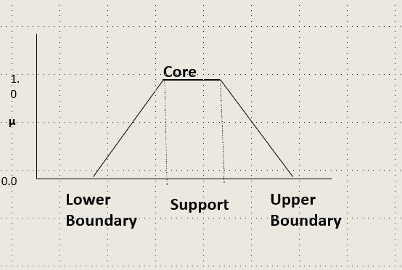
Support(A) and Core

Slide 25
Linguistic variable, linguistic term
Linguistic variable: A linguistic variable is a
variable whose values are sentences in a
natural or artificial language.
For example, the values of the fuzzy variable height could be tall, very tall, very very tall, somewhat tall, not very tall, tall but not very tall, quite tall, more or less tall.
Tall is a linguistic value or primary term

Slide 26
Linguistic variable, linguistic term…
If age is a linguistic variable then its term set is
T(age) = { young, not young, very young, not very young,……
middle aged, not middle aged,
… old, not old, very old, more or less old, not very old,…not very young and not very old,…}.

Slide 27
a. A ∩ B = B ∩ A
Self-Assessment Questions
a. A ∩ B = B ∩ A
Fuzzy operation used for union is
Max
Invert
min
The linguistic hedge A={very far , far, near , very near} is an acceptable fuzzy set
True
False

Slide 28
TERMINAL QUESTIONS
1. Describe membership function
2. List out various terminologies of membership function
3. Analyze the set
A={0.1/0 + 0.2/1 + 0.4 / 2 + 0.6/3 +1/0.66}
B={1/0 + 0.5/1 + 0.7/2 + 0.3 / 3 + 0/4 }
And Find A U B`
4. Summarize open and close membership functions

Slide 29
THANK YOU

